Slide 1
Unit 4 ATP Synthase motor, Bacterial flagellar motor, Cytoskeleton, Biosensors and Bioremediation

Slide 2
ATP SYNTHASE MOTOR
An enzyme within our body's cells called an ATP Synthase.
Like any other motor it rotates, and surprisingly fast - in fact at about 6,000 revs per minute.
Further, it is being 200,000 times smaller than a pinhead.
The ATP Synthase motor's job is to manufacture a little molecule called ATP - short for Adenosine triphosphate - which is of enormous importance for the successful functioning of our bodies.
ATP synthase is an enzyme that directly generates adenosine triphosphate (ATP) during the process of cellular respiration.
ATP is the main energy molecule used in cells. ATP synthase forms ATP from adenosine diphosphate (ADP) and an inorganic phosphate (Pi) through oxidative phosphorylation, which is a process in which enzymes oxidize nutrients to form ATP.

Slide 3
Function
The function of ATP synthase is to produce ATP.
ATP is necessary to power all cellular processes, so it is constantly being used by cells and constantly needs to be produced.
Each ATP synthase can produce about 100 molecules of ATP every second. Eukaryotes, such as plants, animals, and fungi, have organelles called mitochondria that mainly function as ATP producers.
Plants also have chloroplasts that contain ATP synthase and can produce ATP from sunlight and carbon dioxide.
Bacteria and archaea, which make up the prokaryotes, do not have mitochondria but produce ATP through similar cellular respiration processes in their plasma membrane.
Across all forms of life, ATP synthase has basically the same structure and function.

Slide 4
Structure
ATP Synthase has two parts.
The part embedded within the membrane of the mitochondria (in eukaryotes), thylakoid membrane of the chloroplast (only in plants), or plasma membrane (in prokaryotes) is called FO. This is a motor that is powered by H+ ions flowing across the membrane.
The part within the mitochondria, stroma of the chloroplast, or inside the bacterial or archaeal cell is called F1-ATPase, which has α, β and γ subunits. This is another motor that is used to generate ATP.
These two parts are thought to have been two separate structures with two different functions that eventually evolved into ATP synthase. The FO region is similar to DNA helicases (enzymes that unzip DNA so that it can be used as a template for reproduction), while the F1-ATPase region is similar to the H+ motors that allow flagella, arm-like appendages on some bacteria, to move. F1-ATPase has a central stalk and rotor that, when turned, converts ADP and Pi into ATP.

Slide 5
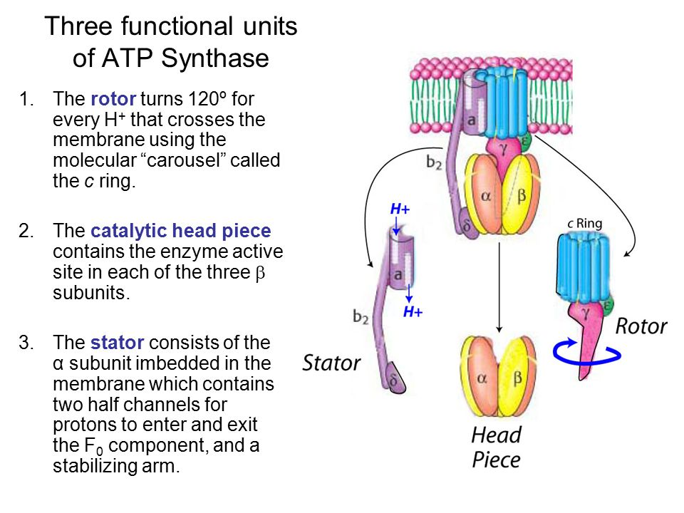
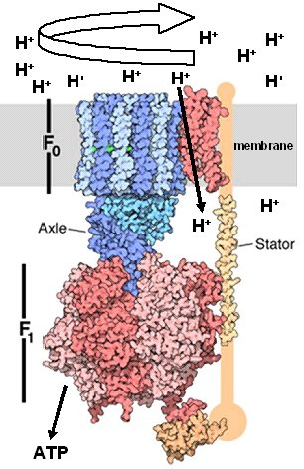
Structure
Model of the F-ATP synthase showing the Fo and F1 complexes, the central stalk (Axle) and the Stator that prevents rotation of F1

Slide 6
Mechanism
In the mitochondria of eukaryotes, the molecules NADH and FADH2, which are products of the citric acid cycle, pass electrons down an electron transport chain, where they travel through three different protein complexes.
This process releases energy, and this energy allows protons (H+ ions) to travel down a proton gradient through the protein complexes, which act as proton pumps. The flow of these protons down the gradient turns the rotor and stalk of the ATP synthase, which makes it possible for a phosphate group to join with adenosine diphosphate (ADP), forming ATP. In chloroplasts, the process is similar, except light energy is the type of energy that excites electrons, causing them to flow down the electron transport chain and enable H+ ions to travel through a membrane in the chloroplast.

Slide 7
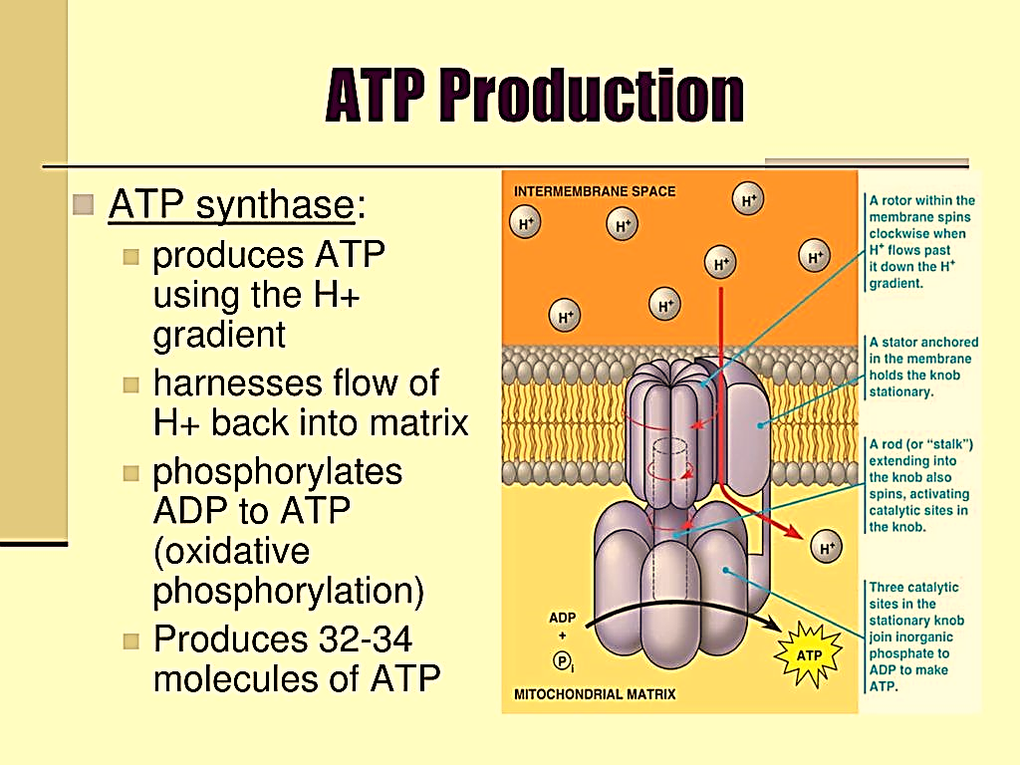
Mechanism

Slide 8
Bacterial Flagellar Motor
Flagella (s., flagellum) is a threadlike locomotor appendages extending outward from the plasma membrane and cell wall.
Size: 20 nm across and up to 15 or 20 m long.
structure of a flagellum can only be seen in the electron microscope because the size is very thin.

Slide 9
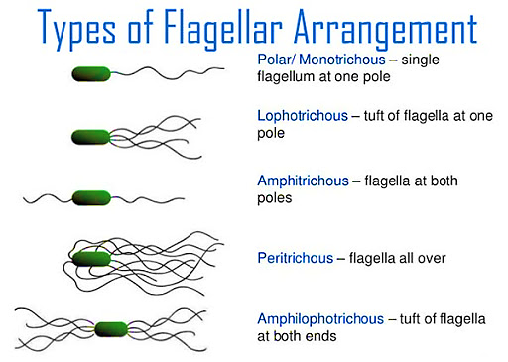
Types of Flagella
Bacterial species often differ distinctively in their patterns of flagella distribution.
Monotrichous bacteria (trichous means hair) have one flagellum. It is located at an end, it is said to be a polar flagellum.
Amphitrichous bacteria (amphimeans “on both sides”) have a single flagellum at each pole.
In contrast, lophotrichous bacteria (lopho means tuft) have a cluster of flagella at one or both ends.
Flagella are spread fairly evenly over the whole surface of peritrichous (peri means “around”) .

Slide 10
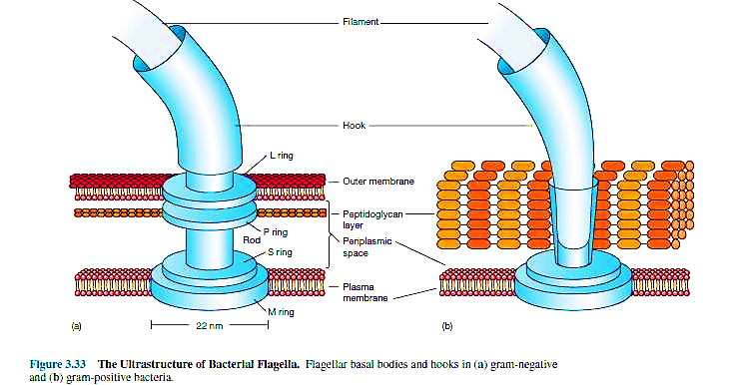
Flagella Structure
Flagellum is composed of three parts:
Filament
The longest and most obvious portion is the filament, which extends from the cell surface to the tip.
The filament is a hollow, rigid cylinder constructed of a single protein called flagellin, which ranges in molecular weight from 30,000 to 60,000. The filament ends with a capping protein.
Basal body
A basal body is embedded in the cell
Hook
a short, curved segment, the hook, links the filament to its basal body and acts as a flexible coupling.

Slide 11
Hook & Basal body
The hook and basal body are quite different from the filament. Slightly wider than the filament.
The hook is made of different protein subunits.
The basal body is the most complex part of a flagellum.
In E.coli and most gram-negative bacteria, the body has four rings connected to a central rod.
The outer L and P rings associate with the lipopolysaccharide and peptidoglycan layers, respectively.
The inner M ring contacts the plasma membrane.
Gram positive bacteria have only two basal body rings, an inner ring

Slide 12
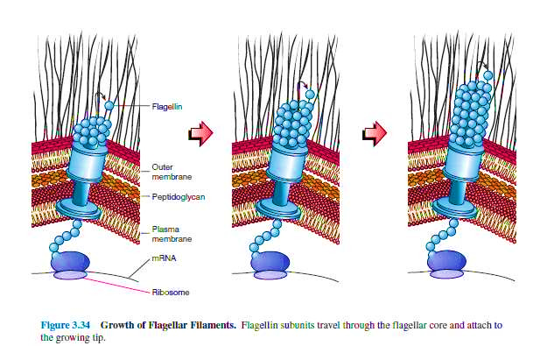
Flagellar Synthesis
The synthesis of flagella is a complex process involving at least 20 to 30 genes.
Besides the gene for flagellin, 10 or more genes code for hook and basal body proteins; other genes are concerned with the control of flagellar construction or function.
Flagellin subunits are transported through the filament’s hollow internal core.
When they reach the tip, the subunits spontaneously aggregate under the direction of a special filament cap so that the filament grows at its tip rather than at the base.
Filament synthesis is an excellent example of self- assembly.

Slide 13
Mechanism of Flagellar Movement
Flagella act just like propellers on a boat.
Bacterial mutants with straight flagella or abnormally long hook regions (polyhook mutants) cannot swim.
Monotrichous, polar flagella rotate counterclockwise (when viewed from outside the cell) during normal forward movement, whereas the cell itself rotates slowly clockwise.
Bacteria swim through rotation of their rigid flagella, there must be some sort of motor at the base. A rod or shaft extends from the hook and ends in the M ring, which can rotate freely in the plasma membrane.
S ring is attached to the cell wall in gram-positive cells and does not rotate. The P and L rings of gram-negative bacteria would act as bearings for the rotating rod. There is some evidence that the basal body is a passive structure and rotates within a membrane- embedded protein complex much like the rotor of an electrical motor turns in the center of a ring of electromagnets (the stator).

Slide 14
Mechanism of Flagellar Movement
The rotor portion of the motor seems to be made primarily of a rod, the M ring, and a C ring joined to it on the cytoplasmic side of the basal body.
These two rings are made of several proteins; Fli G is particularly important in generating flagellar rotation.
The two most important proteins in the stator part of the motor are Mot A and Mot B.
These form a proton channel through the plasma membrane, and Mot B also anchors the Mot complex to cell wall peptidoglycan.
There is some evidence that Mot A and Fli G directly interact during flagellar rotation. This rotation is driven by proton or sodium gradients in prokaryotes, not directly by ATP as is the case with eukaryotic flagella.

Slide 15
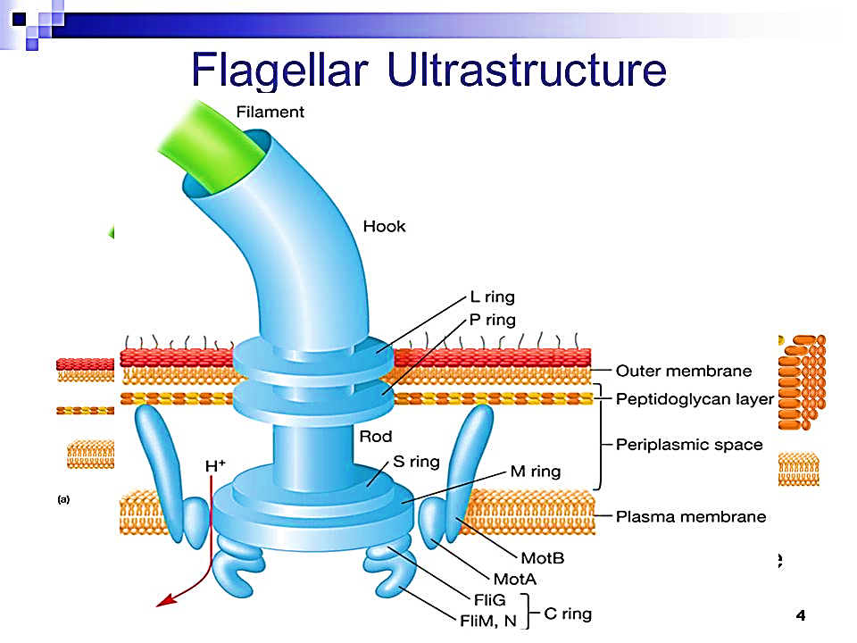
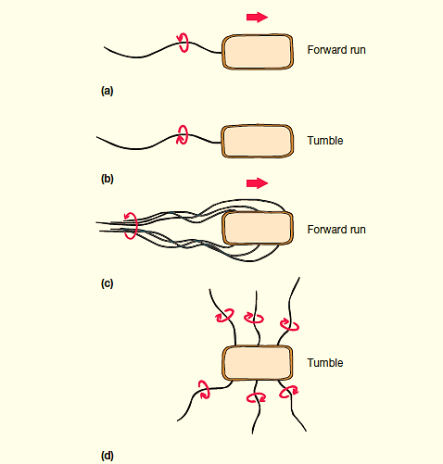
Flagellar Movement

Slide 16
Thank You

